Slide 1
We’ll be starting shortly!
To help us run the workshop smoothly, please kindly:
Submit all questions using the Q&A function
If you have an urgent request, please use the “Raise Hand” function
To know:
To obtain the slides and files: https://LccLcoding.com/shopee
There are 2 x 5-min breaks in the workshop
Thank you!

Slide 2

Python Intermediate
by

Slide 3

Welcome!
Your trainer and facilitator from LCCL Coding Academy today:
Juliana & Yue Da
Use the Q & A.
Participate!

Slide 4
What You Will Learn
18:30 Segment 1
Dictionary
Tuple
Set
Comprehensions
Useful things
19:00 Hands-on
19:15 Break
19:20 Segment 2
Files
Exception handling
19:40 Hands-on
19:55 Break
20:00 Algorithms Hands-On
20:45 Q&A
21:00 End

Slide 5

Ready for lots of hands-on and learning?

Slide 6
Hands-On #0
Create a list of prime numbers between 0 and 100.
Sum these prime numbers.
Calculate the digit sums of these prime numbers.
String the prime numbers into a big string.
Prime numbers between 0 and 100:
[2, 3, 5, 7, 11, 13, 17, 19, 23, 29, 31, 37, 41, 43, 47, 53, 59, 61, 67, 71, 73, 79, 83, 89, 97]
Sum:
1060
Digit Sums:
[2, 3, 5, 7, 2, 4, 8, 10, 5, 2, 4, 10, 5, 7, 2, 8, 5, 7, 4, 8, 10, 7, 2, 8, 7]
String of primes:
2357111317192329313741434753596167717379838997

Slide 7
Hands-On #1
Print the number of unique case-sensitive characters in a string.
String: AppLe
Unique chars:4
String: aPple
Unique chars:5
String: aaa
Unique chars:1

Slide 8
Hands-On #2
Take an input string and report groups of words that start with the same letter.
report('''
Someday I'll wish upon a star
Wake up where the clouds are far behind me
Where trouble melts like lemon drops
High above the chimney top
That's where you'll find me
'''
)
{
'S': {'someday', 'star'},
'I': {"i'll"},
'W': {'where', 'wake', 'wish'},
'U': {'upon', 'up'},
'A': {'are', 'above', 'a'},
'T': {'top', 'trouble', "that's", 'the'},
‘C': {'chimney', 'clouds'},
'F': {'find', 'far'},
'B': {'behind'},
'M': {'melts', 'me'},
'L': {'lemon', 'like'},
'D': {'drops'},
'H': {'high'},
'Y': {"you'll"}
}

Slide 9
How did you find Hands-On #0 - #2?

Slide 10

Be back in 5 mins

Slide 11
What You Will Learn
18:30 Segment 1
Dictionary
Tuple
Set
Comprehensions
Useful things
19:00 Hands-on
19:15 Break
19:20 Segment 2
Files
Exception handling
19:40 Hands-on
19:55 Break
20:00 Algorithms Hands-On
20:45 Q&A
21:00 End

Slide 12
Hands-On #3
Read a file. Report the number of words in the file that start with a consonant, and number of words that start with vowels.
# for myfile
Words that start with consonants: 13
Words that start with vowels : 3

Slide 13
Hands-On #4
Write a program that reads a Python file. The program removes comments from the input file and output the same Python program without comments. Ignore cases where comments appear in a string.
# Creating a tuple
scores = tuple()
scores = ()
scores = (1,2,3,1,1)
# Accessing a value
scores[2] # 3
scores = tuple()
scores = ()
scores = (1,2,3,1,1)
scores[2]

Slide 14
How did you find Hands-On #3 - #4?

Slide 15
Be back in 5 mins

Slide 16
What You Will Learn
18:30 Segment 1
Dictionary
Tuple
Set
Comprehensions
Useful things
19:00 Hands-on
19:15 Break
19:20 Segment 2
Files
Exception handling
19:40 Hands-on
19:55 Break
20:00 Algorithms Hands-On
20:45 Q&A
21:00 End

Slide 17

WARM UP

Slide 18
Hands-On #5
Write a function, multsum that takes a number, n. It outputs the sum of multiples of 3 and 5 from 0 up to but not including n.
multsum(15) # 45, from 3+5+6+9+10+12
multsum(0) # 0
multsum(-10) # 0
multsum(100) # 2315

Slide 19
Hands-On #6
Write a function, repeats, that take a string. It outputs the number of characters that occur more than once in that string. Ignore casing.
repeats(‘aaaa’) # 0
repeats(‘abBA’) # 2
repeats(‘Indivisibility’) # 1
repeats(‘Indivisibilities’) # 2

Slide 20
Hands-On #8
Trolls are spamming your social media comments with random words. You troll back by spamming them with the same words but with vowels replaced by *.
troll(‘Unuseful function’) # *n*s*f*l f*nct**n

Slide 21
How did you find the Warm-Up?

Slide 22
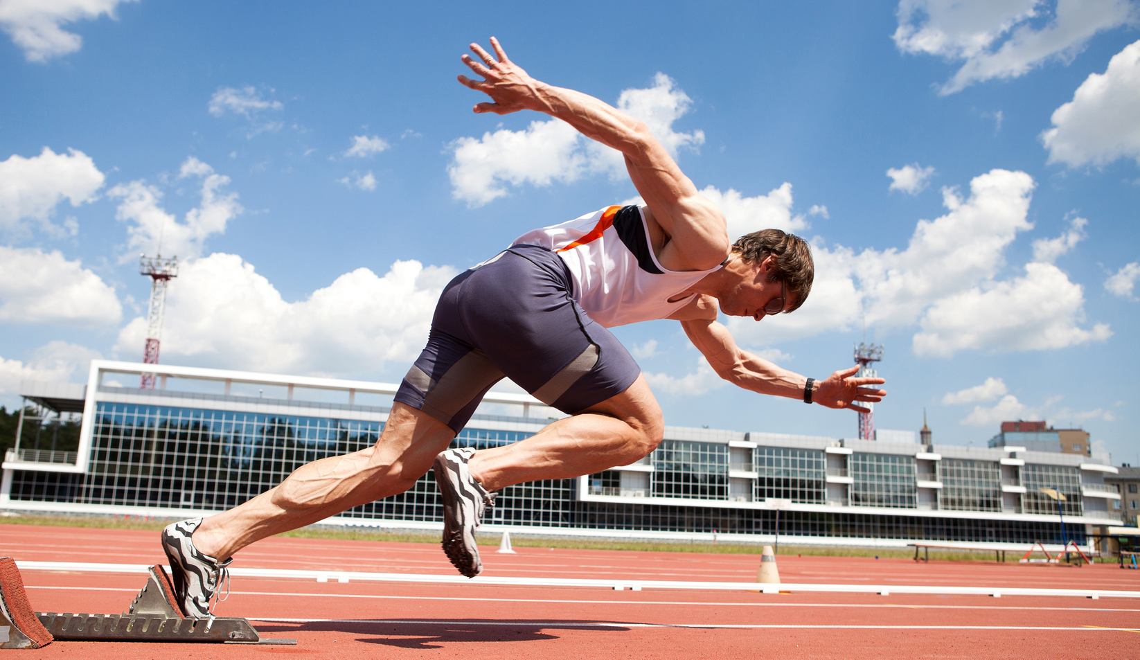
SPRINT!

Slide 23
Hands-On #9
Write a function to convert RGB values to hexadecimal representation. Valid decimal values for RGB are 0 - 255. Values that fall out of that range must be rounded to the closest valid value.
rgb(255, 255, 255) # FFFFFF
rgb(255, 255, 300) # FFFFFF
rgb(0,0,0) # 000000
rgb(148, 0, 211) # 9400D3

Slide 24
Hands-On #10
Create a Pig Latin translator. Rules to convert English to Pig Latin:
Words that start with a vowel will end with ‘ay’ e.g. ‘eggs’ → ‘eggsay’
Words that start with a consonant will have its consonant group move to the end and appended with ‘ay’ e.g. ‘shop’ → ‘opshay’
Treat ‘y’ as a vowel
Enter a sentence: i love the elegance of python
iay ovelay ethay eleganceay ofay ythonpay

Slide 25
Hands-On #11
Create a function that behaves this way:
foo(["run","jump","run","jump","run"],"_|_|_") # "_|_|_"
foo(["run","jump","run","run","run"],"_|_|_") # "_|_/_"
foo(["run","run","run","run","run"],"_|_|_") # "_/_/_"
foo(["jump","jump","jump","jump","jump"],"_|_|_") # "x|x|x"
foo(["jump","run","jump","run","jump"],"_|_|_") # "x/x/x"

Slide 26
Hands-On #12
Given an n x n matrix, return a list of elements with a sequence of elements from the matrix ‘spiralling in’.
m = [[1]]
[1]
m = [[1,2],
[4,5]]
[1, 2, 5, 4]
m = [[1,2,3],
[4,5,6],
[7,8,9]]
[1, 2, 3, 6, 9, 8, 7, 4, 5]
m = [[1,2,3,1],
[4,5,6,4],
[7,8,9,7],
[7,8,9,7]]
[1, 2, 3, 1, 4, 7, 7, 9, 8, 7, 7, 4, 5, 6, 9, 8]

Slide 27
How did you find the Sprints?

Slide 28
Q & A

Slide 29
Thank You

Slide 30
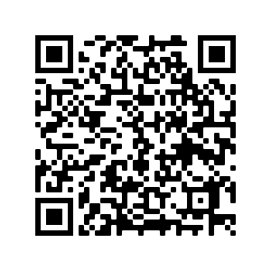
Your Feedback Matters!
https://techatshopee.formstack.com/forms/shopeecodeleague_workshopfeedbackform

